Slide 1
Way To Fly: Airline Reservation System
Way To Fly: Airline Reservation System
By-
Vaibhav Gangwar (10662951)
Venkata Manoj Vatadi (10653474)
Himanshu Singh (10662759)
Ajith Pentapati (10653398)

Slide 2
Abstract
Way To Fly is a Single Page Airline Reservation web application which provides a user-friendly Interface and an easy efficient way to search and book flight tickets. This application is currently working for a single airline company and only for domestic flights.
User have access to search flights and apply for it. User can register on website to search for flights and book tickets. On booking it provides a unique ticket number through which user can track its flight details.
It also gives the functionality to ADMIN to View, ADD and Delete the particular flight.

Slide 3
Technologies Used
ANGULAR8 FRAMEWORK
SQL Server Management Studio V18.6
ASP.NET WEBAPI
POSTMAN

Slide 4
Required Modules
ADMIN MODULE
Admin Module
Admin Login
Add & Delete Flight
Login
Register
Flight Search
Flight Select
Payment
USER MODULE

Slide 5
Implemented Modules
ADMIN MODULE
ADMIN LOGIN
ADD & DELETE FLIGHT
USER MODULE
LOGIN
REGISTER
FLIGHT SEARCH
FLIGHT SELECT
PAYMENT

Slide 6
Coming Soon….
Cancel Flight
Forgot Password

Slide 7
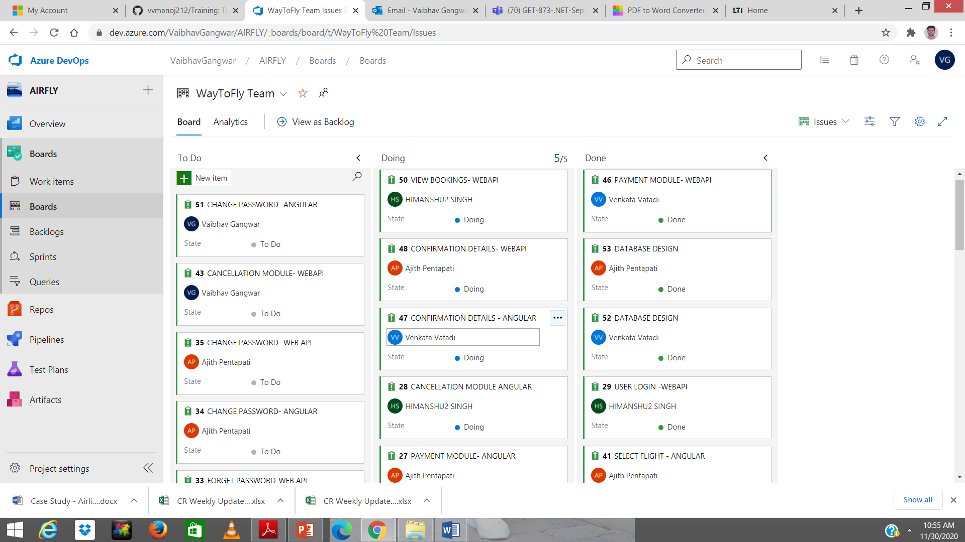
SCRUM BOARD
Source- dev.azure.com

Slide 8
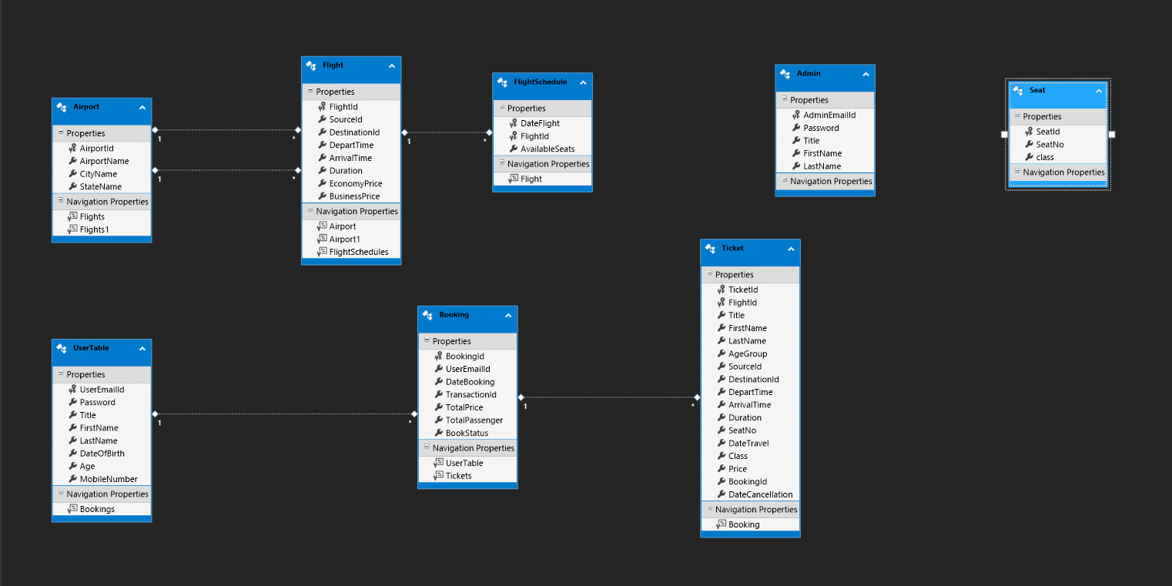
Database Design

Slide 9
Screenshots of All the Modules
Screenshots of All the Modules

Slide 10
User-Login

Slide 11
User-Registration

Slide 12
Flight-Search

Slide 13
Flight-Select

Slide 14
Flight-Booking

Slide 15
Payment

Slide 16
Admin Login

Slide 17
View Flight

Slide 18
Add Flight

Slide 19
Delete Flight

